Slide 1
Week 4 Class 1:
Human System Vulnerabilities
INST408C: Cognitive Security | Fall 2021 | SJ Terp

Slide 2
Week 4
Monday
Human system vulnerabilities and patches
From clicks to disinformation
cognitive biases and their abuses
the range of ways users and groups are influenced online (and offline via online means) - user experience, marketing and adtech, online political campaigns, astroturfing, online psyops, disinformation campaigns.
Wednesday
Psychology of influence
Outcome: articulate common influence techniques.
Applying marketing models
The medium is the message: Content vs Context

Slide 3
Who targets you

Slide 4
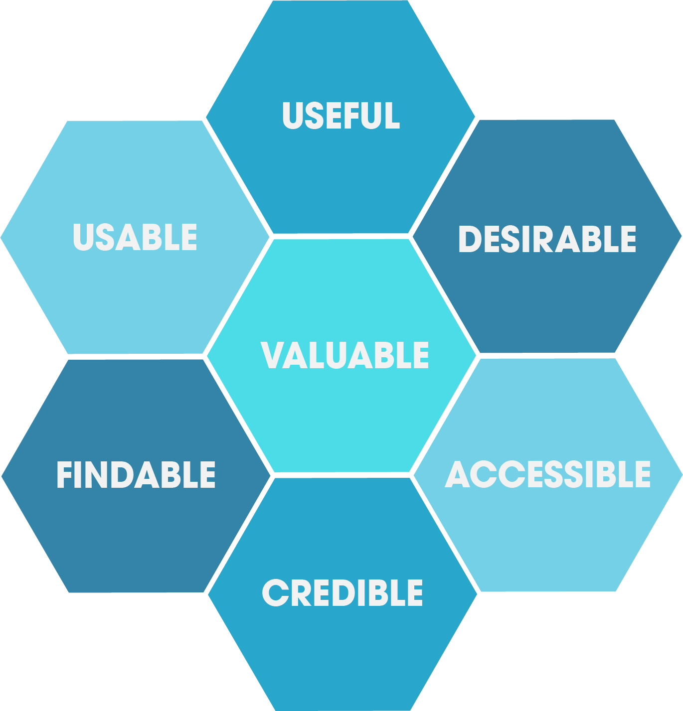
User experience designers

Slide 5
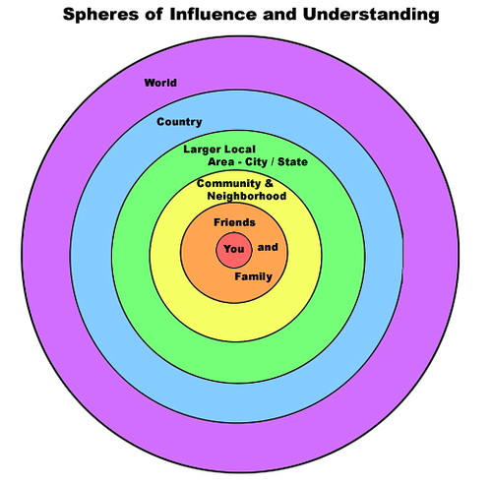
Friends, family etc
Notes:
Image: https://www.flickr.com/photos/veraciousjess/284998971

Slide 6
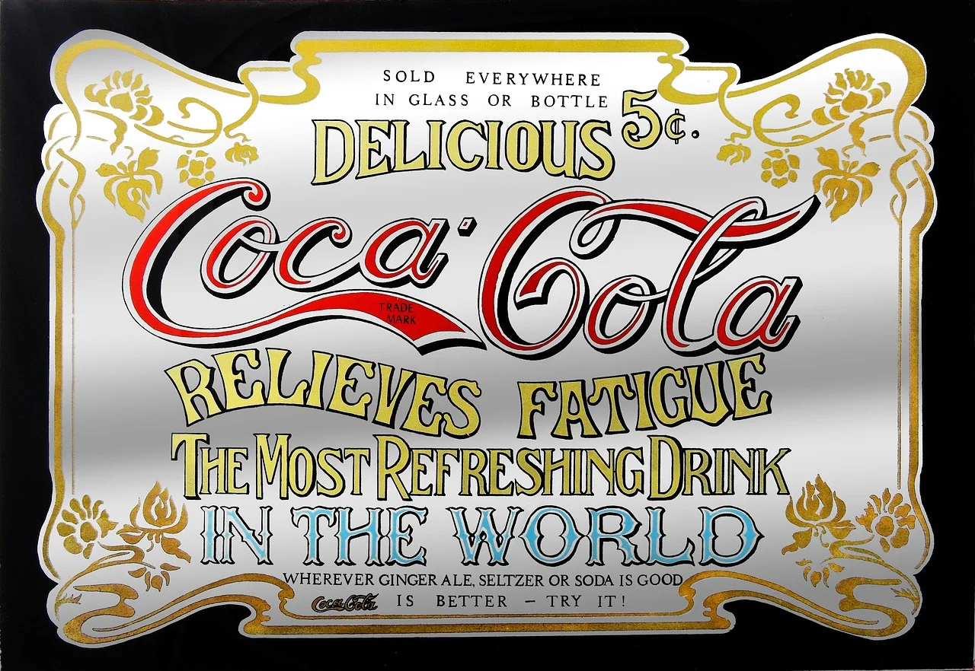
Advertisers

Slide 7
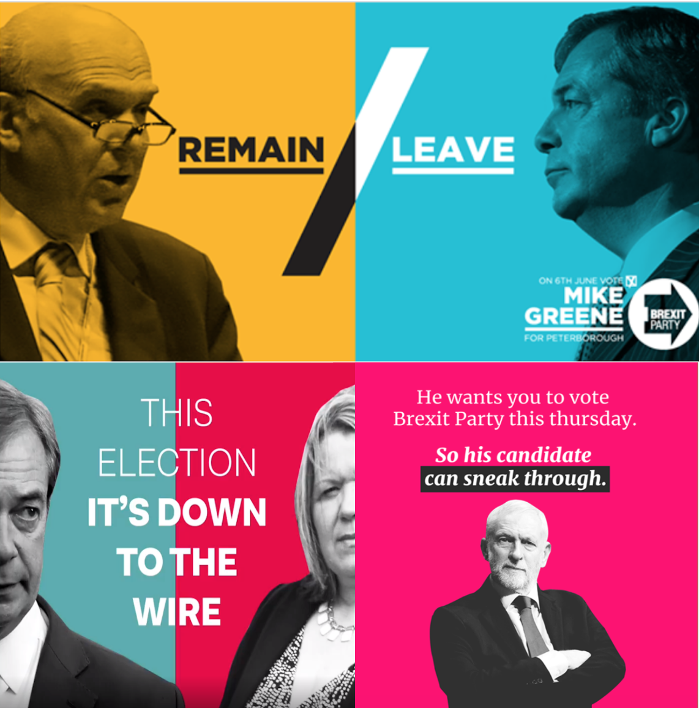
Political campaigns

Slide 8

Psyops, disinformation, misinformation etc
Notes:
Image: US army psyops

Slide 9
Cognitive biases

Slide 10
Bias
Systematic deviation from the true answer
Doesn’t have to be malicious, or have negative effects on people
Example: people tend to be overconfident about their own driving ability
Other examples of bias?

Slide 11
Heuristics and biases
People aren’t actually unpredictable; there are systematic ways that we are biased
Which is more dangerous, sharks or vending machines? Which one kills more people each year? Which one should you run away from?
Just because reasoning isn’t “rational” doesn’t mean it isn’t useful
Which is more likely, that you’ll get hacked by the Chinese military or that your information will be stolen by an Estonian credit card farm?

Slide 12
Bounded rationality
People bounded by their own cognition
What are some examples of cognitive limits?
People also bounded by the structure of the information available in the world
Can’t know if there is more information that you haven’t seen
What is an example of a situation where you don’t know if you have all the information?
If you could consider all the possibilities at once, what might happen?

Slide 13
System 1 and System 2 thinking
System 1: automatic processes that give you an answer quickly without a lot of effort
System 2: effortful reasoning, considering all the possibilities

Slide 14
Specific biases (and their abuses)

Slide 15
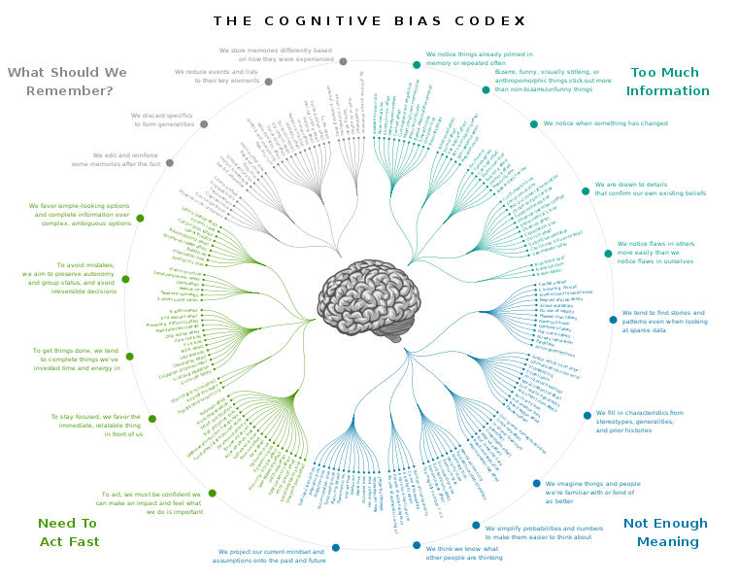
Cognitive Bias Codex
Chart of about 200 biases
Each of these is a vulnerability

Slide 16
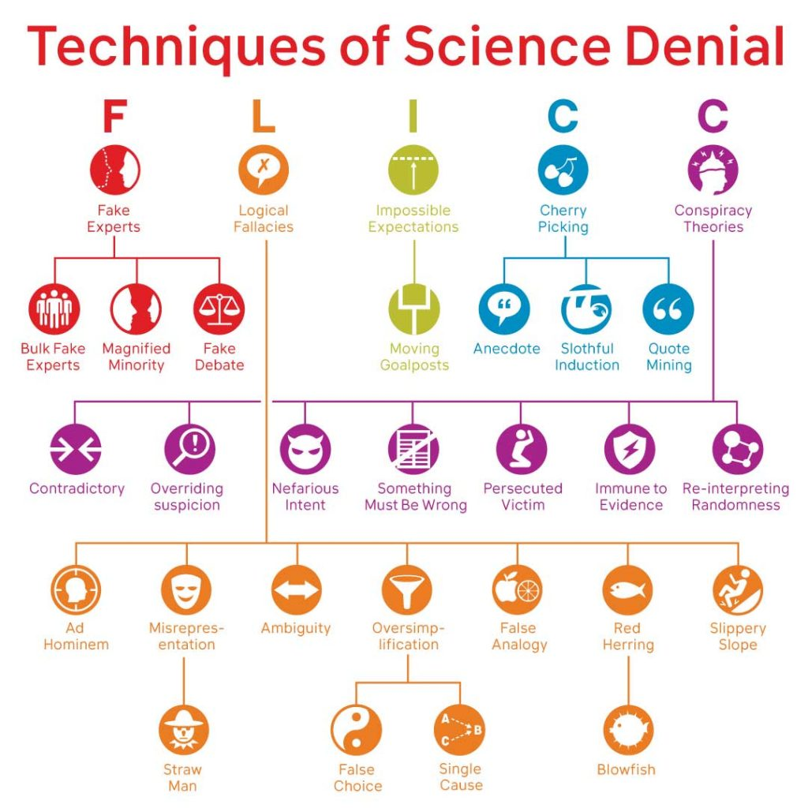
FLICC
John Cook
Denial tactics:
Fake experts
Logical fallacies
Impossible expectations
Cherry picking
Conspiracy theories
Originally designed for climate change, HIV/AIDs etc crossover
Notes:
https://skepticalscience.com/history-FLICC-5-techniques-science-denial.html

Slide 17
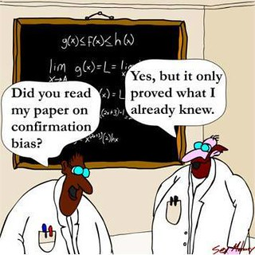
Confirmation bias
Believe what you want to believe
Desire >> facts
Notes:
https://www.psychologytoday.com/us/blog/science-choice/201504/what-is-confirmation-bias

Slide 18
Counter: Dennett’s 4 points
1. Attempt to re-express your target’s position so clearly, vividly and fairly that your target says: “Thanks, I wish I’d thought of putting it that way.”
2. List any points of agreement (especially if they are not matters of general or widespread agreement).
3. Mention anything you have learned from your target.
4. Only then are you permitted to say so much as a word of rebuttal or criticism.
Notes:
https://techindc.com/confirmation-bias/3063/

Slide 19
Illusory truth bias
Believing something is true if it’s easy to understand, or repeated multiple times
Well hello, online advertising…
See also availability bias: Overestimating the likelihood or influence of things that are more visible / recent / emotionally charged (salience bias)
See also frequency illusion: noticing something more, once you’ve focussed on it (like seeing your make of car more once you’ve bought it)

Slide 20
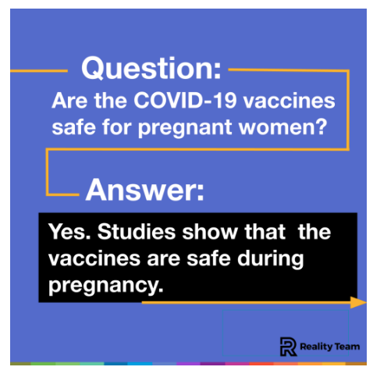
Counter: countermessaging

Slide 21
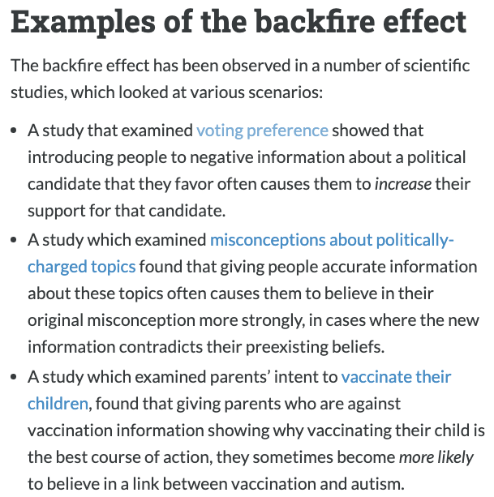
Familiarity backfire effect
Under dispute -
Doubling down on beliefs when they’re challenged
See also Semmelweis reflex: rejecting new contradicting evidence
Notes:
Image: https://effectiviology.com/backfire-effect-facts-dont-change-minds/

Slide 22
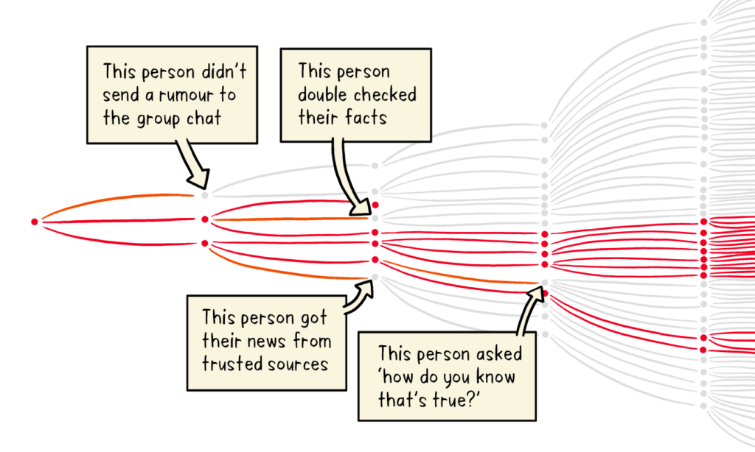
Counters: Pre-bunking and truth sandwiches
Notes:
https://firstdraftnews.org/articles/a-guide-to-prebunking-a-promising-way-to-inoculate-against-misinformation/
https://medium.com/wehearthealthliteracy/the-truth-sandwich-a-better-way-to-mythbust-8021d2cf8730
Truth sandwich: truth, lie, truth
Image: WHO
Includes playing “Go Viral!”

Slide 23
Information overload
Three Vs: too much information, too fast, too varied
Affect: emotional language = more likely to be shared
Messenger: trust people we know more
Notes:
https://www.scientificamerican.com/article/biases-make-people-vulnerable-to-misinformation-spread-by-social-media/
https://link.springer.com/chapter/10.1007%2F978-3-642-22309-9_5

Slide 24
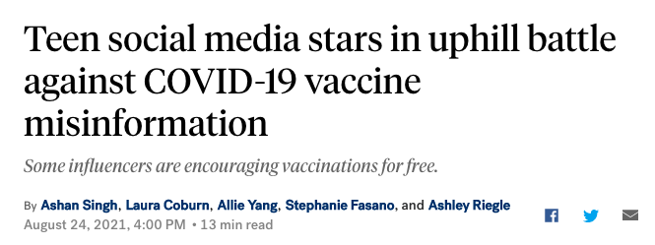
Counter: improve the information/influence environment
Notes:
Indian aunties. Barbershops. Etc.

Slide 25
Trust and vulnerable communities
Trust boundaries
E.g. External low-trust, internal high-trust
See also: authority bias - believing authority figures more
Fake experts use these

Slide 26

Practice: Fake experts

Slide 27
Online community biases
“Do your research”
Echo chambers: Different search terms, different profiles, give different results

Slide 28
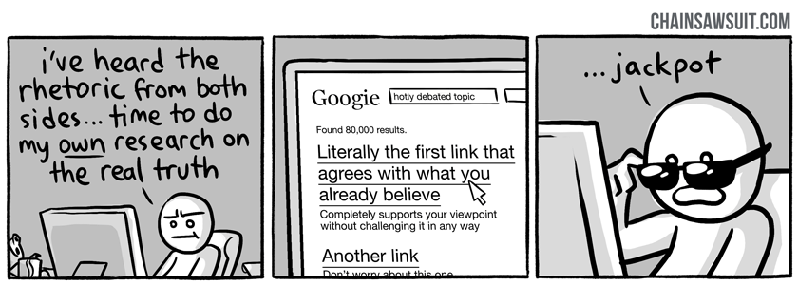
Practice: “do your research”
Notes:
https://thinkingispower.com/the-problem-with-doing-your-own-research/

Slide 29
Counter: truth sandwiches
TRUE
FALSE
TRUE

Slide 30
Algorithm biases
Filter bubbles: you’re training the algorithm on what you want to see
(Try searching in incognito mode… )
Homogeneity bias: platform uses small number of sources
Popularity bias: popular content != quality
Astroturfing etc use these

Slide 31
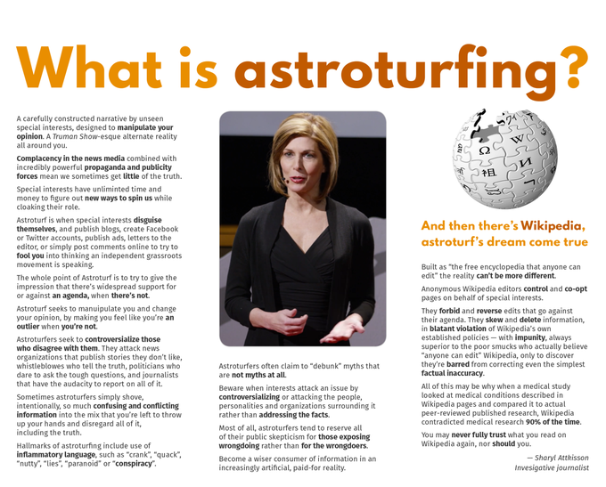
Practice: Astroturfing
Notes:
Image: https://knowyourmeme.com/photos/923510-wikipedia

Slide 32
Counter: report, remove, re-route
Again, build a better information / influence environment
Notes:
https://www.demdigest.org/a-better-way-to-counter-astroturfing-disinformation-technology-and-democracy-in-transition/

